Slide 1
Normal distribution

Slide 2
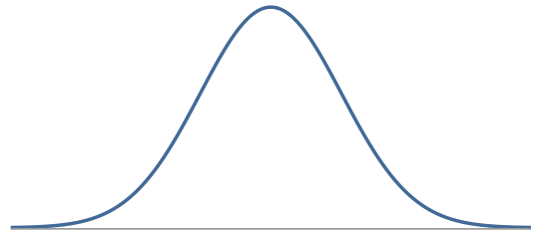
Normal Distribution
Symmetric, bell shaped curve
Many variables are nearly normal, but none are exactly normal
Denoted as N(µ, σ) → Normal with mean µ and standard deviation σ

Slide 3
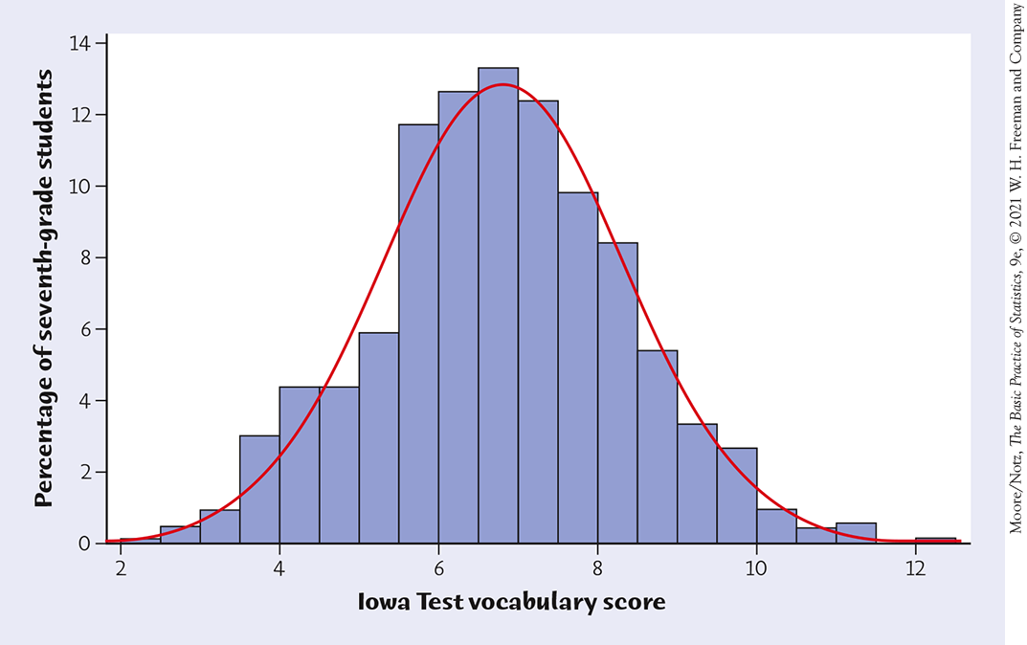
Density Curves
Example: Here is a histogram of the vocabulary scores of 947 seventh-graders.
The smooth curve closely approximates the tops of the histogram bars and provides a good description of the overall data pattern.

Slide 4
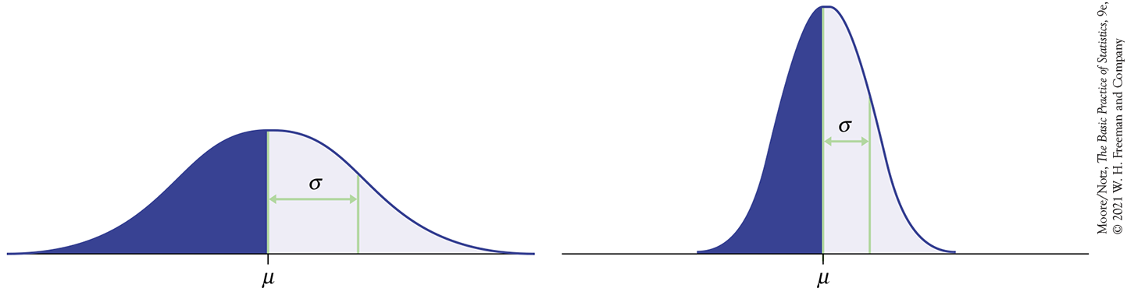

Normal distributions with different parameters
$$N\left(μ,σ\right)$$

Slide 5
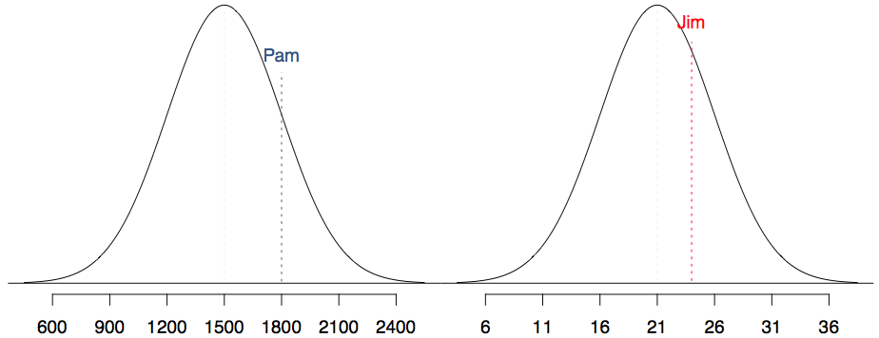
SAT scores are distributed nearly normally with mean 1500 and standard deviation 300. ACT scores are distributed nearly normally with mean 21 and standard deviation 5. A college admissions officer wants to determine which of the two applicants scored better on their standardized test with respect to the other test takers: Pam, who earned an 1800 on her SAT, or Jim, who scored a 24 on his ACT?

Slide 6
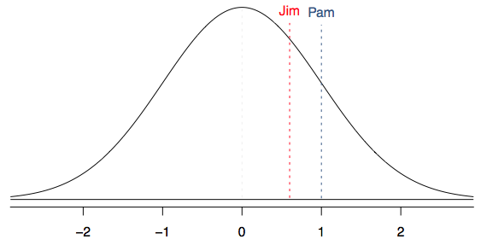
Standardizing with Z scores
Since we cannot just compare these two raw scores, we instead compare how many standard deviations beyond the mean each observation is.
Pam's score is (1800 - 1500) / 300 = 1 standard deviation above the mean.
Jim's score is (24 - 21) / 5 = 0.6 standard deviations above the mean.

Slide 7
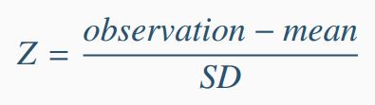

Standardizing with Z scores (cont.)
These are called standardized scores, or Z scores.
Z score of an observation is the number of standard deviations it falls above or below the mean.
Observations that are more than 2 SD away from the mean are usually considered unusual. (Some books use 3 SD)
$$Z=\frac{x−μ}{σ}$$

Slide 8
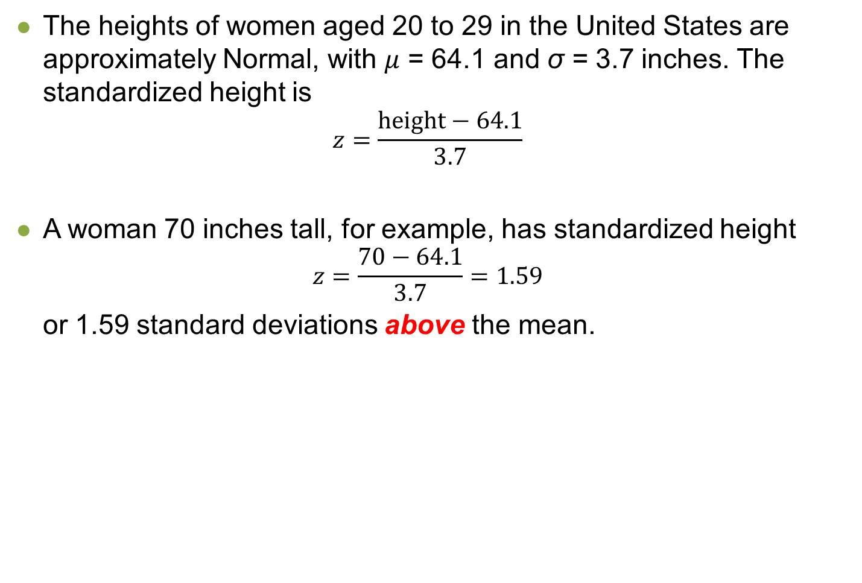
Standardizing with Z scores (cont.)
The heights of women aged 20 to 29 in the United States are approximately Normal, with $μ$ = 64.1 and σ = 3.7 inches. The standardized height is
$$z=\frac{\text{height}−64.1}{3.7}$$
A woman 70 inches tall, for example, has standardized height
$$z=\frac{\text{70}−64.1}{3.7}=1.59$$
or 1.59 standard deviations above the mean.

Slide 9
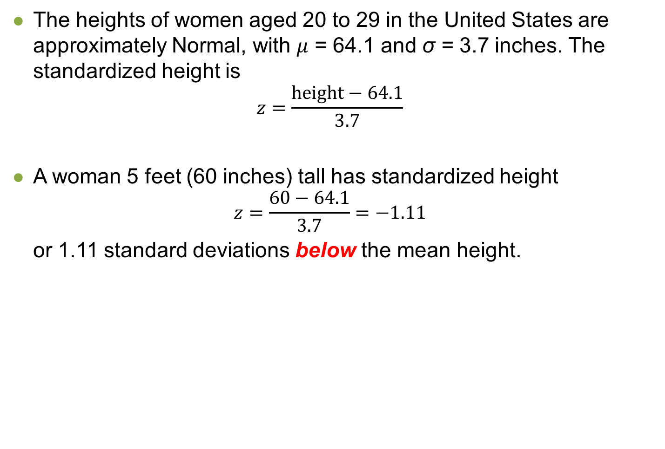
Standardizing with Z scores (cont.)
The heights of women aged 20 to 29 in the United States are approximately Normal, with $μ$ = 64.1 and σ = 3.7 inches. The standardized height is
$$z=\frac{\text{height}−64.1}{3.7}$$
A woman 5 feet (60 inches) tall has standardized height
$$z=\frac{\text{6}\text{0}−64.1}{3.7}=−1.11$$
or 1.11 standard deviations below the mean height.

Slide 10
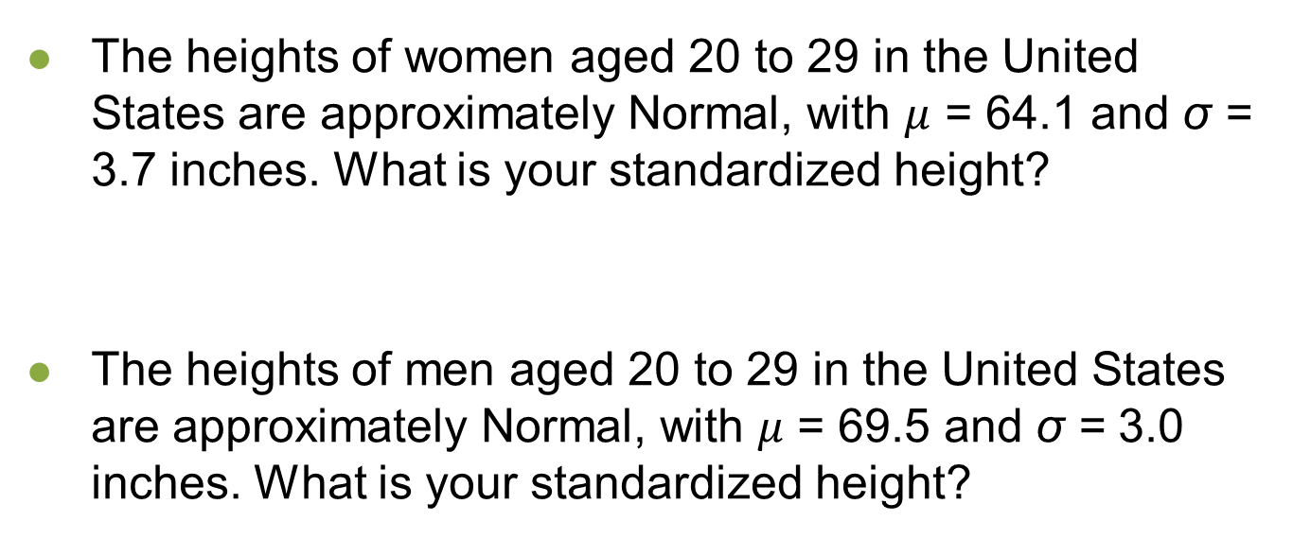
Practice
The heights of women aged 20 to 29 in the United States are approximately Normal, with $μ$ = 64.1 and σ = 3.7 inches. What is your standardized height?
The heights of men aged 20 to 29 in the United States are approximately Normal, with $μ$ = 69.5 and σ = 3.0 inches. What is your standardized height?

Slide 11
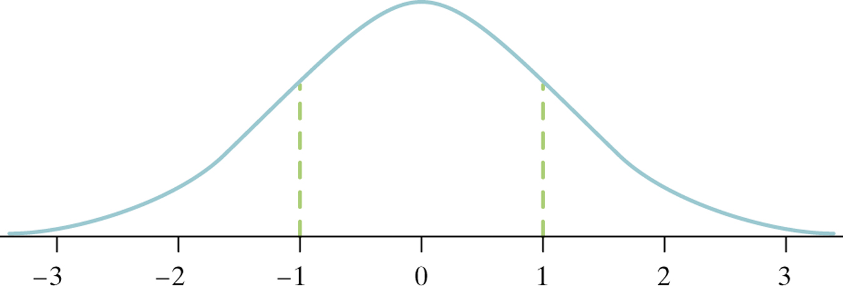
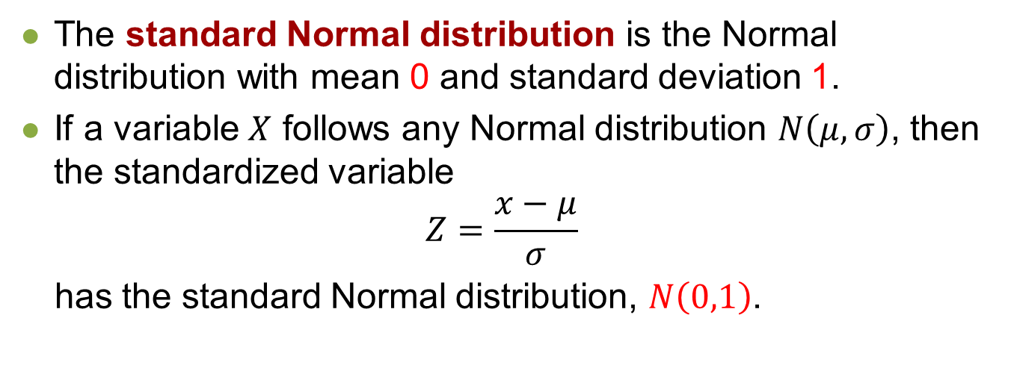
The Standard Normal Distribution
The standard Normal distribution is the Normal distribution with mean 0 and standard deviation 1.
If a variable $X$ follows any Normal distribution $N\left(μ,σ\right)$, then the standardized variable
$$Z=\frac{x−μ}{σ}$$
has the standard Normal distribution, $N\left(0,1\right)$.

Slide 12
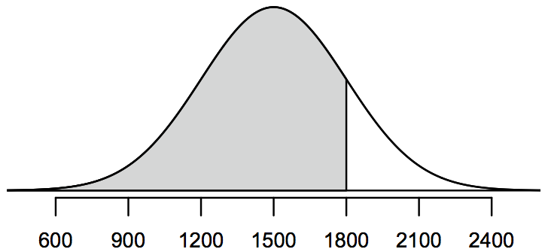
Recall: Percentiles
Percentile is the percentage of observations that fall below a given data point.
Graphically, percentile is the area below the probability distribution curve to the left of that observation.

Slide 13
Calculating percentiles -
using computation
There are many ways to compute percentiles/areas under the curve. R:

Slide 14
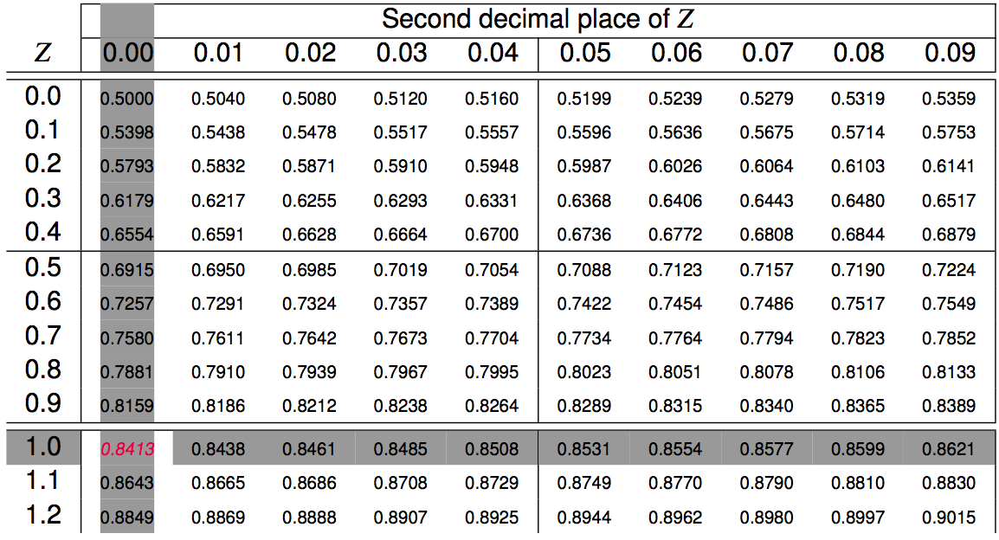
Calculating percentiles -
using tables

Slide 15
Quality control
At Heinz ketchup factory the amounts which go into bottles of ketchup are supposed to be normally distributed with mean 36 oz. and standard deviation 0.11 oz. Once every 30 minutes a bottle is selected from the production line, and its contents are noted precisely. If the amount of ketchup in the bottle is below 35.8 oz. or above 36.2 oz., then the bottle fails the quality control inspection. What percent of bottles have less than 35.8 ounces of ketchup?

Slide 16
Quality control
At Heinz ketchup factory the amounts which go into bottles of ketchup are supposed to be normally distributed with mean 36 oz. and standard deviation 0.11 oz. Once every 30 minutes a bottle is selected from the production line, and its contents are noted precisely. If the amount of ketchup in the bottle is below 35.8 oz. or above 36.2 oz., then the bottle fails the quality control inspection. What percent of bottles have less than 35.8 ounces of ketchup?
Let X = amount of ketchup in a bottle: X ~ N(µ = 36, σ = 0.11)

Slide 17
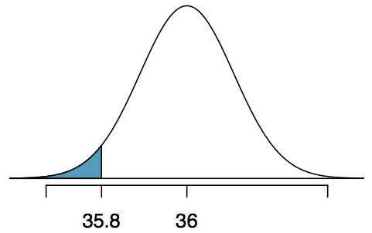
Quality control
At Heinz ketchup factory the amounts which go into bottles of ketchup are supposed to be normally distributed with mean 36 oz. and standard deviation 0.11 oz. Once every 30 minutes a bottle is selected from the production line, and its contents are noted precisely. If the amount of ketchup in the bottle is below 35.8 oz. or above 36.2 oz., then the bottle fails the quality control inspection. What percent of bottles have less than 35.8 ounces of ketchup?
Let X = amount of ketchup in a bottle: X ~ N(µ = 36, σ = 0.11)

Slide 18
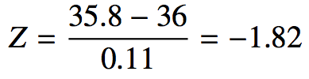
Quality control
At Heinz ketchup factory the amounts which go into bottles of ketchup are supposed to be normally distributed with mean 36 oz. and standard deviation 0.11 oz. Once every 30 minutes a bottle is selected from the production line, and its contents are noted precisely. If the amount of ketchup in the bottle is below 35.8 oz. or above 36.2 oz., then the bottle fails the quality control inspection. What percent of bottles have less than 35.8 ounces of ketchup?
Let X = amount of ketchup in a bottle: X ~ N(µ = 36, σ = 0.11)

Slide 19
Finding the exact probability - using R
> pnorm(-1.82, mean = 0, sd = 1)
[1] 0.0344
OR
> pnorm(35.8, mean = 36, sd = 0.11)
[1] 0.0345

Slide 20
Practice
What percent of bottles pass the quality control inspection?
(a) 1.82% (c) 6.88%
(b) 3.44% (d) 93.12%

Slide 21
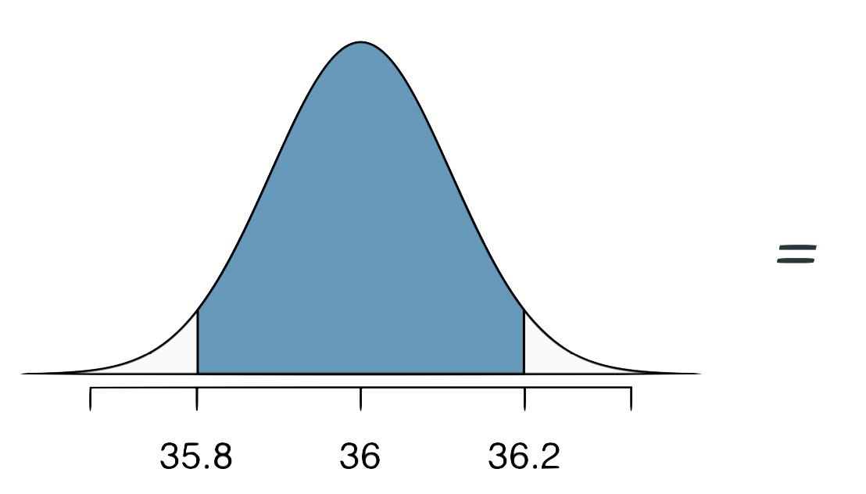
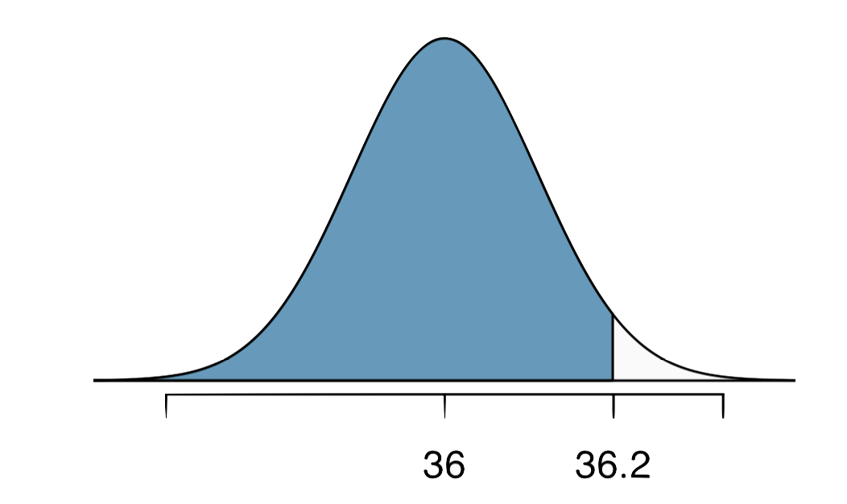
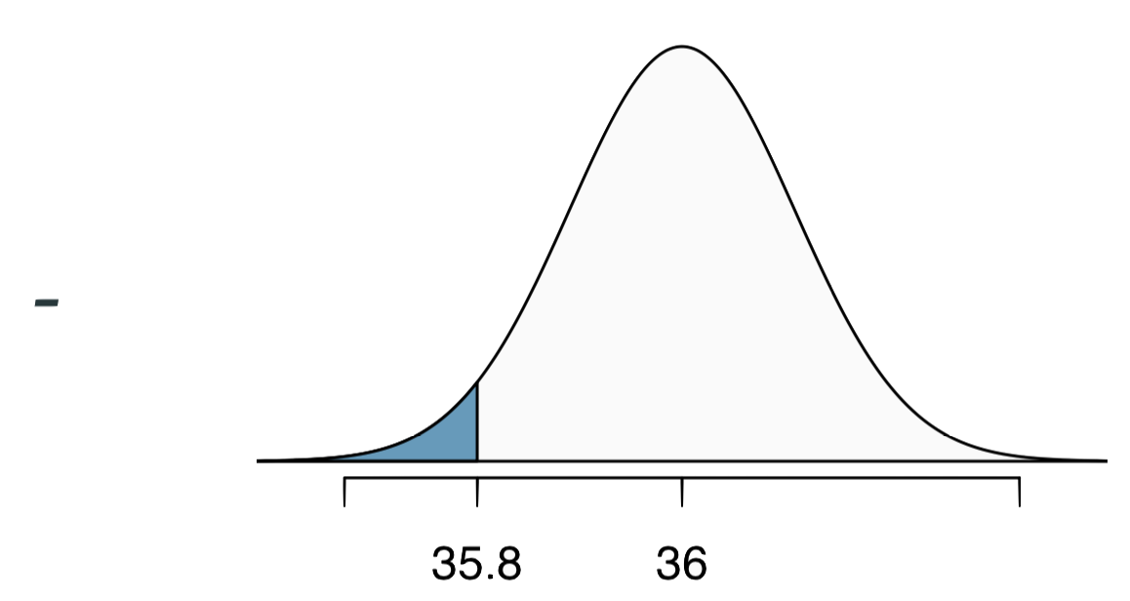
Practice
What percent of bottles pass the quality control inspection?
(a) 1.82% (c) 6.88%
(b) 3.44% (d) 93.12%

Slide 22
Finding cutoff points
Body temperatures of healthy humans are distributed nearly normally with mean 98.2ºF and standard deviation 0.73ºF. What is the cutoff for the lowest 3% of human body temperatures?

Slide 23
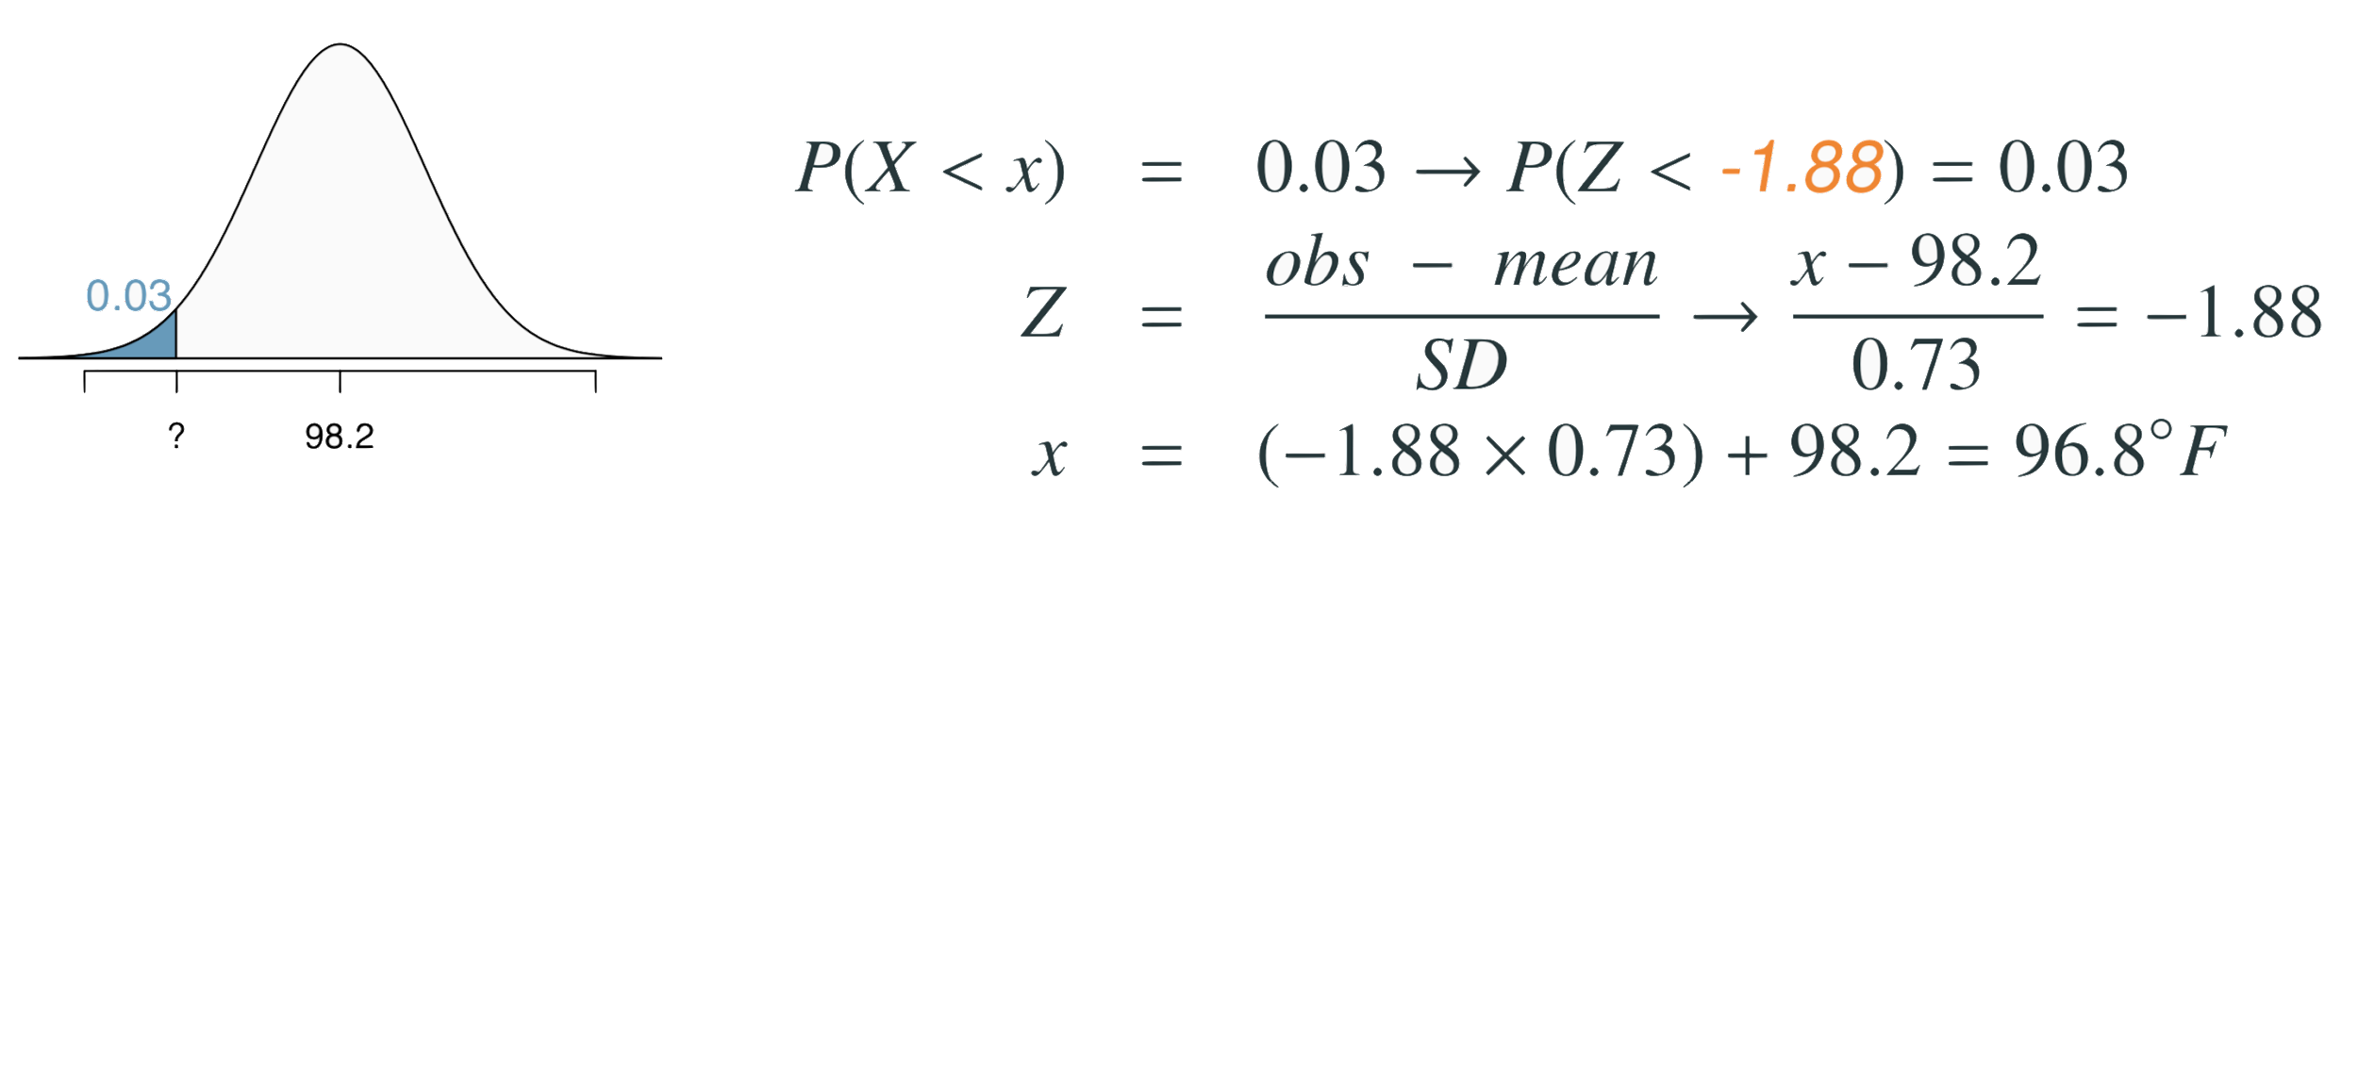
Finding cutoff points
Body temperatures of healthy humans are distributed nearly normally with mean 98.2ºF and standard deviation 0.73ºF. What is the cutoff for the lowest 3% of human body temperatures?

Slide 24
Finding cutoff points
Body temperatures of healthy humans are distributed nearly normally with mean 98.2ºF and standard deviation 0.73ºF. What is the cutoff for the lowest 3% of human body temperatures?

Slide 25
Finding cutoff points
Body temperatures of healthy humans are distributed nearly normally with mean 98.2ºF and standard deviation 0.73ºF. What is the cutoff for the lowest 3% of human body temperatures?

Slide 26
Finding cutoff points
Body temperatures of healthy humans are distributed nearly normally with mean 98.2ºF and standard deviation 0.73ºF. What is the cutoff for the lowest 3% of human body temperatures?

Slide 27
Finding cutoff points
Body temperatures of healthy humans are distributed nearly normally with mean 98.2ºF and standard deviation 0.73ºF. What is the cutoff for the lowest 3% of human body temperatures?
> qnorm(0.03)
[1] -1.880794
Mackowiak, Wasserman, and Levine (1992), A Critical Appraisal of 98.6 Degrees F, the Upper Limit of the Normal Body Temperature, and Other Legacies of Carl Reinhold August Wunderlick.

Slide 28
Practice
Body temperatures of healthy humans are distributed nearly nor- mally with mean 98.2ºF and standard deviation 0.73ºF. What is the cutoff for the highest 10% of human body temperatures?
(a) 97.3ºF (c) 99.4ºF
(b) 99.1ºF (d) 99.6ºF

Slide 29
Practice
Body temperatures of healthy humans are distributed nearly nor- mally with mean 98.2ºF and standard deviation 0.73ºF. What is the cutoff for the highest 10% of human body temperatures?
(a) 97.3ºF (c) 99.4ºF
(b) 99.1ºF (d) 99.6ºF

Slide 30
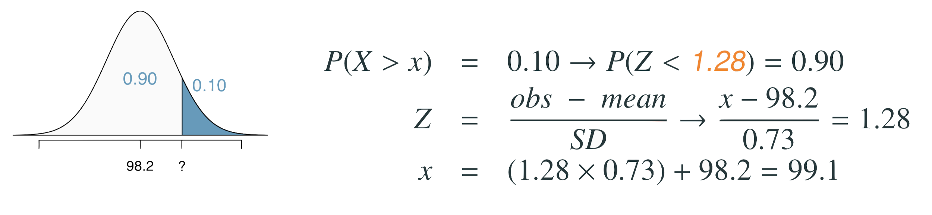
Practice
Body temperatures of healthy humans are distributed nearly nor- mally with mean 98.2ºF and standard deviation 0.73ºF. What is the cutoff for the highest 10% of human body temperatures?
(a) 97.3ºF (c) 99.4ºF
(b) 99.1ºF (d) 99.6ºF

Slide 31
Practice
Body temperatures of healthy humans are distributed nearly nor- mally with mean 98.2ºF and standard deviation 0.73ºF. What is the cutoff for the highest 10% of human body temperatures?
(a) 97.3ºF (c) 99.4ºF
(b) 99.1ºF (d) 99.6ºF

Slide 32
Practice
Body temperatures of healthy humans are distributed nearly nor- mally with mean 98.2ºF and standard deviation 0.73ºF. What is the cutoff for the highest 10% of human body temperatures?
(a) 97.3ºF (c) 99.4ºF
(b) 99.1ºF (d) 99.6ºF

Slide 33
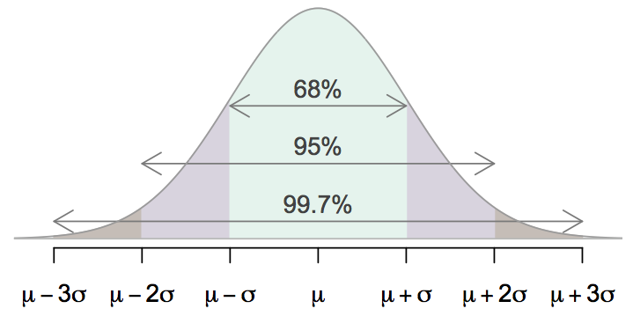
68-95-99.7 Rule
For nearly normally distributed data,
about 68% falls within 1 SD of the mean,
about 95% falls within 2 SD of the mean,
about 99.7% falls within 3 SD of the mean.
It is possible for observations to fall 4, 5, or more standard deviations away from the mean, but these occurrences are very rare if the data are nearly normal.

Slide 34
Describing variability using the 68-95-99.7 Rule
SAT scores are distributed nearly normally with mean 1500 and standard deviation 300.

Slide 35
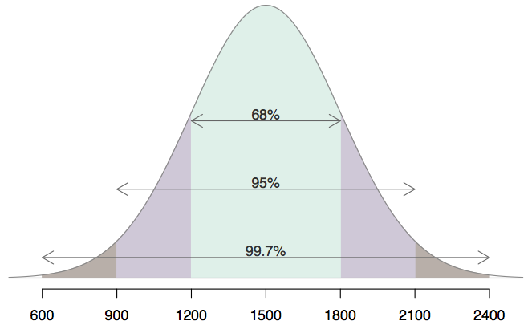
Describing variability using the 68-95-99.7 Rule
SAT scores are distributed nearly normally with mean 1500 and standard deviation 300.
~68% of students score between 1200 and 1800 on the SAT.
~95% of students score between 900 and 2100 on the SAT.
~$99.7% of students score between 600 and 2400 on the SAT.

Slide 36
Appendix
Probability Tables

Slide 37
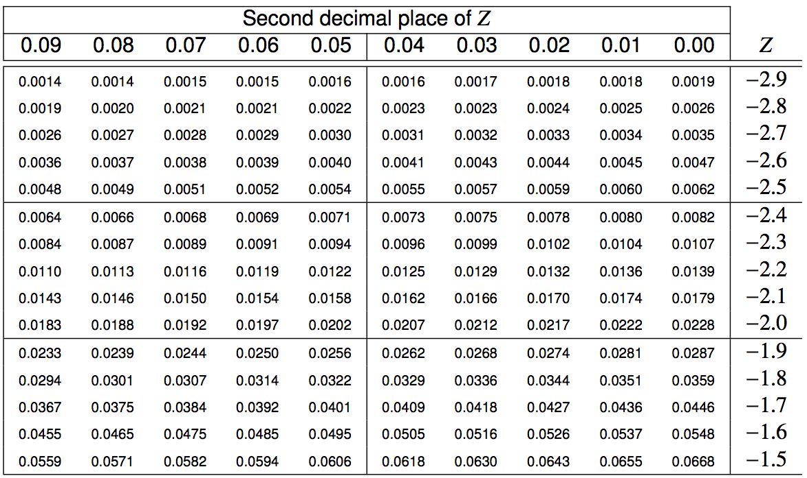
Finding the exact probability - using the Z table

Slide 38
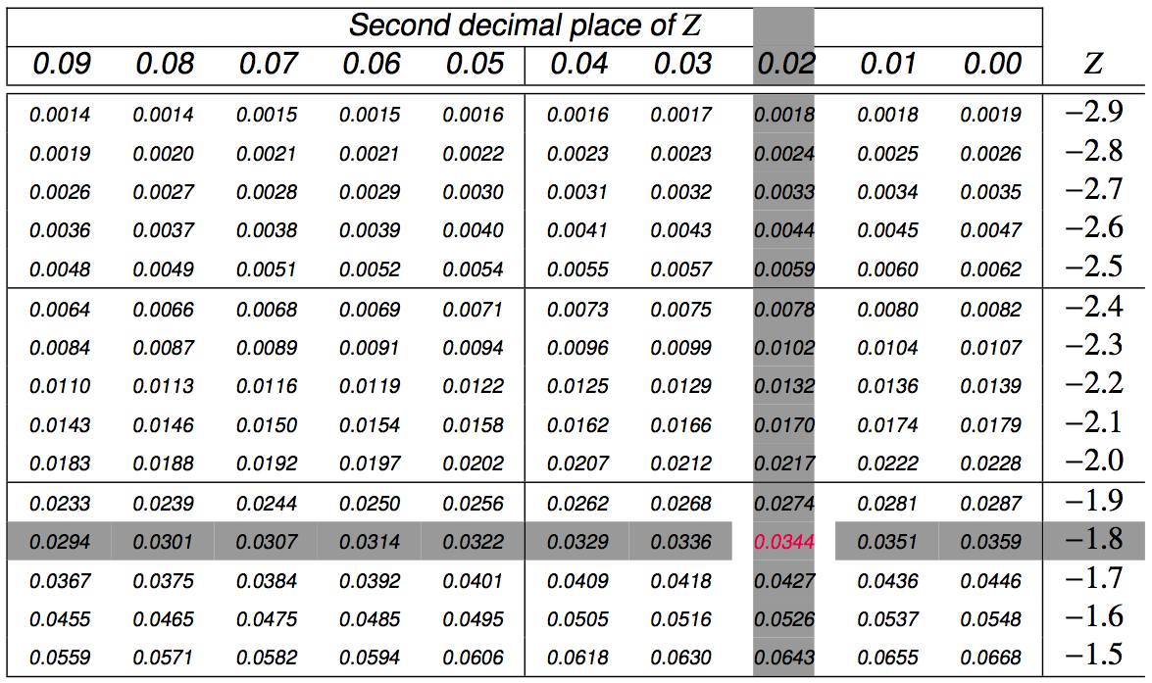
Finding the exact probability - using the Z table

